Slide 1

Accessibility For Digital Contents & Services
Subash Acharya
03/22/2022

Slide 2

Digital Accessibility to improve User Experience
Nearly 20% (every 1 in 5) people in the world have some sort of permanent or temporary disability.
71% of disabled users don’t use website or application simply because digital content is not accessible.
Last year, more then 2000 websites accessibility lawsuits were filed by plaintiffs because they were not ADA (American Disability Act) complaint.
Section 508 of the Rehabilitation Act of 1973 (29 U.S.C § 794 d) & American with disability act of 1990 (ADA)

Slide 3
Research Data: Survey
Disable Group | Common Problems with Digital Contents
Color Blind | Only color is used as a unique marker to emphasize text on a Web site. Text that inadequately contrasts with background color or patterns.
Deaf | Lack of captions or transcripts of audio on the Web, including webcasts. Lack of content-related images in pages full of text.
Low Vision | Web pages with absolute font sizes that do not change. Difficult to navigate when enlarged, due to loss of surrounding context. Web pages, or images on Web pages, that have poor contrast. Text presented as images, which prevents wrapping to the next.
Motor Disabilities | Time-limited response options on Web pages. Tools that do not support keyboard alternatives for mouse. Browsers and authoring tools that lack keyboard support for all commands.
Blind | Images that do not have alternative text Complex images (e.g., graphs or charts) that are not adequately described. tables that do not make sense when read serially (in a cell-by-cell or "linearized" mode) Frames that do not have "NOFRAME" alternatives, or that do not have meaningful names Forms that cannot be tabbed through in a logical sequence or that are poorly labelled.
Seizure | Use of visual or audio frequencies that might trigger seizure.

Slide 4

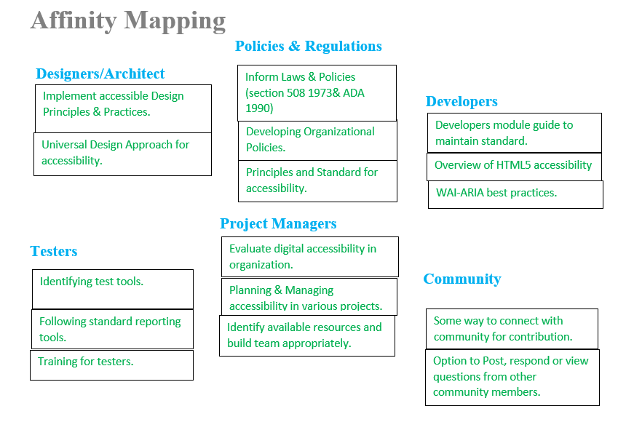
Research Data: Interview

Slide 5
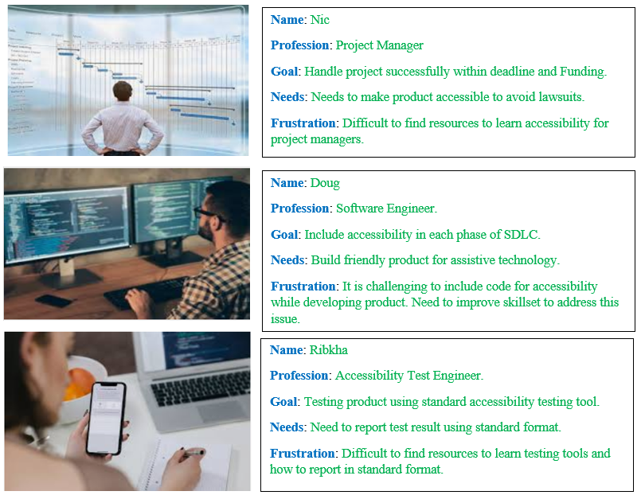
Persona:

Slide 6
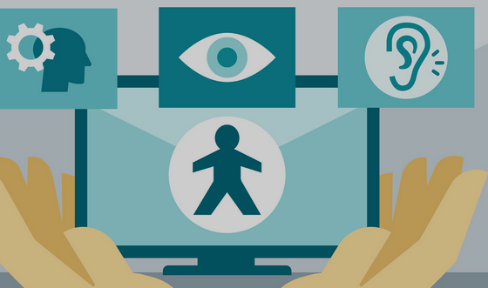
Service Experience
Improve experience of disabled individuals while accessing digital information or services.
Improve skillset of team members who are developing, enhancing or maintaining digital information and services.

Slide 7
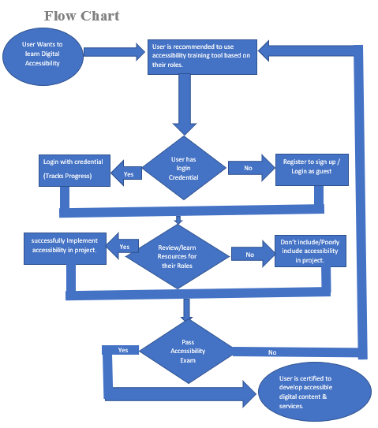

Slide 8
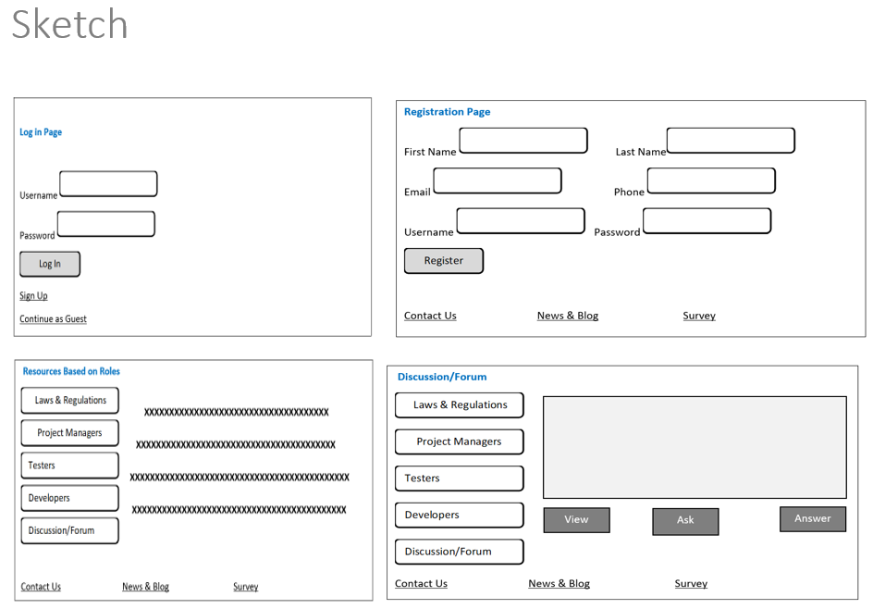

Slide 9

Story Arc
Introduction: Digital accessibility is important to share information &/or services for all including disable users to reach out to more users. Team members should have knowledge to implement accessibility in their project.
Incident: Disable individuals have issue with getting information they need because of lack of accessibility. Team members might not have enough technical skillset about implementing accessibility.
Raising Action: There are some instances of lawsuit action because of accessibility laws.
Climax: Accessibility is the law not feature. Team members must get training based on their role to create accessible project.
Resolution: This tool will provide training for our team members based on their roles and responsibilities. If possible, all disable groups should be addressed.
Conclusion: We must consider accessibility while developing digital content or services. Accessibility must be considered every phases of SDLC.

Slide 10
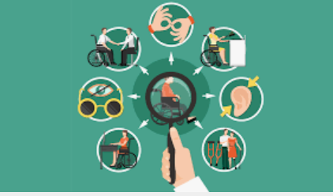
Wireframe & Quick Demo
Please check Wireframe & Design in Figma
Please check Figma Prototype
Get copy of project Class Project in GitHub
Quick demo by running tool in browser (Source code is available in GitHub above)
What’s Next ?
Spread knowledge/Marketing
Build community & Enhance tool
Develop Certification Exam.

